Slide 1

2022
Group members:
Haymanot: M202261025
Jifar: M202261027
Alec: M202161029
DIGITAL Communication - ROUTING AIR AND SPACE, DATA CENTER
-
information and communication department
GROUP 3
Lecturer - 杜冰

Slide 2
DIGITAL COMMUNICATION - ROUTING AIR AND SPACE, SAGIN

Slide 3
Contents
Why Routing is Useful?
Types of Routing
Space-Air-Ground Integrated Network (SAGIN)
Routing System in SAGIN
Factors Affecting Routing System
Algorithm for Routing in SAGIN
Conclusion

Slide 4
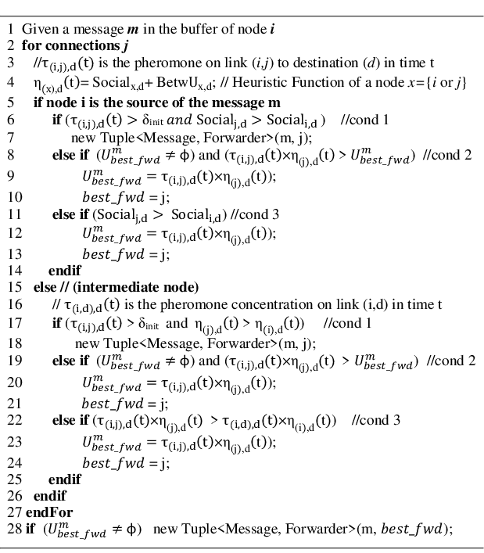
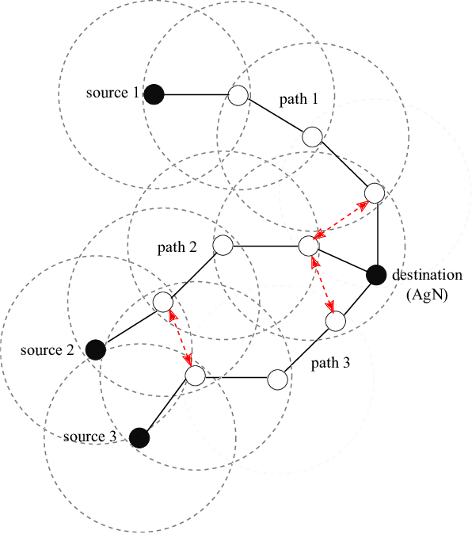
Why Routing is Useful

Slide 5
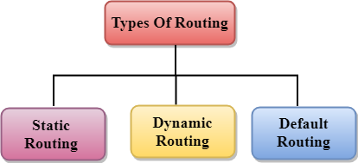
Types Of Routing
Routing is a process that is performed by layer 3 (or network layer) devices in order to deliver the packet by choosing an optimal path from one network to another.

Slide 6
1. Static Routing
It is a technique in which the administrator manually adds the routes in a routing table.
Advantages:
No Overhead: No routing overhead for router CPU which means a cheaper router can be used to do routing.
Security: It adds security because an only administrator can allow routing to particular networks only.
Bandwidth: No bandwidth usage between routers.
Disadvantage:
For a large network, it is a hectic task for administrators to manually add each route for the network in the routing table on each router.
The administrator should have good knowledge of the topology. If a new administrator comes, then he has to manually add each route so he should have very good knowledge of the routes of the topology.

Slide 7
2. Default Routing:
This is the method where the router is configured to send all packets towards a single router (next hop).
It doesn’t matter to which network the packet belongs, it is forwarded out to the router which is configured for default routing.
It is generally used with stub routers. A stub router is a router that has only one route to reach all other networks.

Slide 8
3. Dynamic Routing:
Dynamic routing makes automatic adjustments of the routes according to the current state of the route in the routing table. Dynamic routing uses protocols to discover network destinations and the routes to reach them. RIP and OSPF are the best examples of dynamic routing protocols. Automatic adjustments will be made to reach the network destination if one route goes down.
Features of dynamic protocol :
The routers should have the same dynamic protocol running in order to exchange routes.
When a router finds a change in the topology then the router advertises it to all other routers.
Advantages:
Easy to configure.
More effective at selecting the best route to a destination remote network and also for discovering remote network.
Disadvantage:
Consumes more bandwidth for communicating with other neighbors.
Less secure than static routing.

Slide 9
Space-air-ground integrated network (SAGIN)
Refer to integration of satellite systems, aerial networks, and terrestrial communications, SAGIN has been becoming an emerging architecture and attracted intensive research interest during the past years.
Besides bringing significant benefits for various practical services and applications, SAGIN is also facing many unprecedented challenges due to its specific characteristics, such as heterogeneity, self-organization, and time-variability.
Compared to traditional ground or satellite networks, SAGIN is affected by the limited and unbalanced network resources in all three network segments, so that it is difficult to obtain the best performances for traffic delivery.
Therefore, the system integration, protocol optimization, resource management, and allocation in SAGIN is of great significance.

Slide 10
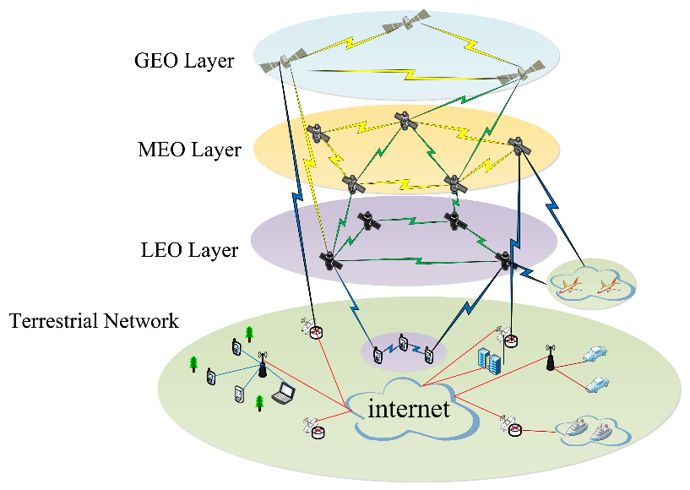
Routing system in SAGIN
Space-air-ground integrated network (SAGIN) has emerged as a paradigm shifting architecture that offers large-scale, flexible wireless coverage and seamless, high-rate connectivity to complement terrestrial communications.
Current maritime communications rely mainly on satellites with weak transmission resources and lesser performance than modern terrestrial wireless networks.
To meet heterogeneous business requirements, SAGIN framework is proposed. However, due to heterogeneity, self-organization, and time unpredictability, designing and optimizing the SAGIN framework is challenging.

Slide 11
Factors affecting routing in satellite network
The Satellite network is an important part of the global network. However, the complex architecture, changeable constellation topology, and frequent inter-satellite connection switching problems bring great challenges to the routing designs of satellite networks, making the study of the routing methods in satellite networks a research hotspot.
In traditional terrestrial networks, Since the topology of the terrestrial network varies less frequently, updating the routing table is no longer necessary once the network reaches a stable state. Meanwhile, the computing power and storage capacity of the router are sufficient to meet the calculation requirements of the routing table, so the existing routing protocols can be better adapted to the terrestrial network.

Slide 12
Algorithms Routing in SAGIN
1) Deep Learning Algorithm
Recent advances in artificial intelligence have generated various routing algorithms for wireless communications, such as deep learning assisted routing algorithms for balancing traffic in SAGINs.
In routing algorithms, the network topology is assumed to be static, and routing decisions are made based on the state of the nodes in the global network. Therefore, to handle highly dynamic network topologies, a deep reinforcement learning assisted routing algorithm for ad hoc aeronautical networking can be used.
The algorithm relies entirely on local information and can achieve near-optimal end-to-end delays. To meet the needs of heterogeneous services and to accommodate the dynamic nature of SAGINs, the authors further propose a DL-assisted multi-objective routing algorithm. The algorithm utilizes a quasi-predictable network topology and operates in a distributed manner.
a DL-assisted routing algorithm that minimizes end-to-end delay to aid comprehension is also proposed. For single destination routing, each snapshot of the network topology can calculate link delays based on each node’s coordinates and delay model. The approach trains a single-objective deep neural network to embed network topology information. During algorithm training, all nodes’ queuing delays are constant. Then, the SO-DNN calculates the minimal delay between each source–destination pair using the shortest path technique. The authors also utilized local information to solve the multi-target routing problem for multi-target routing. Therefore, similar to SO-DNN, the algorithm uses a multi-objective deep neural network (MO-DNN) to learn. Experimental results show that the integrated network achieves better network coverage, lower latency, higher throughput, and a longer path life.

Slide 13
2) Radar detection and estimation
1. Data input: Copy radar scan, of any scan type short, medium or long.
2. Temporal alignment: Compute the elapsed time between radar scans and use it to sample ego motion module for the transformation matrix representing the change in position between radar scans.
3. Egomotion compensation: Use the transformation matrix to rotate and translate the tracked radar object’s state mean, error covariance estimate, and other properties.
4. Spatial alignment: Move the tracking origin from the vehicle coordinate system to the sensor coordinate system to allow proper prediction and data association.
5. Prediction: Estimate the new position and velocity of the tracked objects based on elapsed time between radar scans, as well as the estimation search region for track-to-detection data association.
6.Association: Probabilistically match incoming radar detections with current radar tracks.
7. Update: Use association scores to cluster detections to each track. From clusters update state estimates for position, velocity, acceleration, boundary, statistics and motion type (moving, stationary, stopped). Confirm tracks above certain quality metrics. Remove tracks below certain quality metrics.

Slide 14
Conclusions
Due to limited coverage, radio access provided by ground communication systems is not available everywhere on the Earth, it is necessary to develop a new three-dimensional network architecture in a bid to meet various connection requirements. Space–air–ground integrated networks (SAGINs) offer large coverage.
Space-air-ground integrated networks (SAGINs) are heterogeneous, self-organizing and time-varying wireless networks providing massive and global connectivity. These three characteristics of SAGINs bring great challenges for routing design.
Our idea is on the improvement of routing system for SAGIN Building powerful unsupervised machine learning model which can able to find short path for multi-packet travelling with high speed and good in managing a delivery operation. Working on Route optimization serves the purpose of finding the shortest possible routes for a large number of vehicles.

Slide 15
THANK YOU!
谢谢！

